Slide 1
Natural Language Processing with Bag of Words Models
Matthew Engelhard

Slide 2
Lecture 1: what is a predictive model?
y, associated value or label
x, data/features for a subject or patient
End goal: predict y from x
Notes:
Let’s take a moment to review what we discussed last time
Opportunity to answer questions, which we didn’t have before
We talked about the basics of a predictive model.
It takes a set of data, or features, x, and applies a mathematical function or logic to make a prediction about an associated value, y
The thing that takes x and returns the prediction about y – that’s the model, the ”machine” in machine learning.

Slide 3
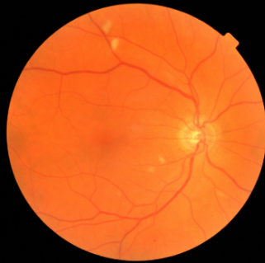
CNN: a predictive model for image data
y, referrable diabetic retinopathy
x, retinal image
End goal: predict y from x
Notes:
So now that we’ve talked about the simplest case
-- what’s a predictive model
-- how do we measure and understand performance – which is what we need to understand well in order to USE them
We’re going to go to the opposite end of the spectrum and talk about an incredibly complex model
-- we’ll talk about how it works
-- but the big thing I want to emphasize is that if we understand what these models are, big picture, and we understand how their performance is and should be measured – that’s what you need to know to be able to use them effectively, as clinicians, in my view.
-- these are just another very fancy diagnostic tool in your toolbox. There are a few caveats, which we’ll discuss at the end
But before we move on – let’s pause for questions.

Slide 4
NLP: a predictive model for text data
y, abnormality present
x, radiology report
End goal: predict y from x

Slide 5

Case Study: SMS Triage for Global Maternal Health
Maternal Health HelpDesk:
2 million women connected to NDoH staff via SMS
https://www.praekelt.org
Binary Classification: Urgent Message? (Yes/No)
Notes:
With all that said, let’s talk a little bit about the details of how we can make predictions using text.
I’m going to move quickly here, so please speak up if/when anything is unclear.

Slide 6
Case Study: SMS Triage for Global Maternal Health
https://www.praekelt.org
Can we use a standard predictive model
setup to solve this problem?
Notes:
F1-score is harmonic mean of the two

Slide 7
A Simple Predictive Model: ICU Mortality
???
WBC Count
Respiratory Rate
Creatinine
Mean BP
Hematocrit
Age
Temperature
Pulse Rate
Survival
End goal: predict odds of hospital mortality
Notes:
ACUTE PHYSIOLOGY AND CHRONIC HEALTH EVALUATION
Predictive models are nothing new in medicine – APACHE, for instance – this is to predict mortality in ICU setting – has been around since the 70s.
In an ICU setting, we might want a model that takes a bunch of measurements about a patient -- their age (demographics), vitals, lab values, and some information about chronic health conditions and predicts their risk of dying (or likelihood of surviving…)

Slide 8
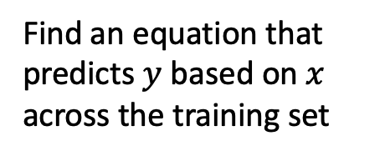
Training Set (Historical Data)
x₁
y₁
Find an equation that predicts $y$ based on $x$ across the training set
x₂
y₂
x₃
y₃
x₄
y₄
…
…
x_{N-1}
y_{N-1}
x_{N}
y_{N}
Notes:
How do we do that?
Gather a bunch of historical data
Want to find an equation that predicts y well based on x across that historical data
Y could be a numeric value, or a rank – but today, we’re going to assume that y is binary.
We model (y) as a Bernoulli random variable – this just means that it’s an event that may or may not occur, with some probability – and we suppose that probability is a function of x
So we take all this data, we use it to find the parameters that are most consistent with the patterns of x and y that are present

Slide 9
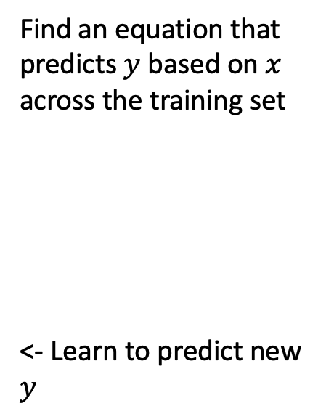

Making Predictions for New $x$
x₁
y₁
x₂
y₂
Find an equation that predicts $y$ based on $x$ across the training set
<- Learn to predict new $y$
x₃
y₃
x₄
y₄
…
…
x_{N-1}
y_{N-1}
x_{N}
y_{N}
x_{N+1}
y_{N+1}
Notes:
Having done that, we have a trained model. Our parameters are learned – we hold them fixed.
Now, when we see a NEW value of x, we simply plug it into our “learned” equation, and it tells us what we expect y to be. This is prediction.

Slide 10
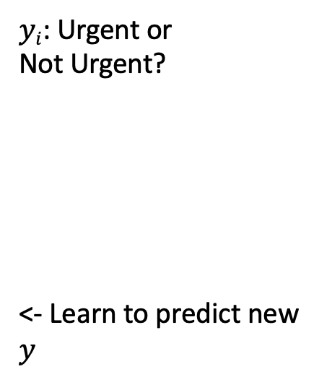
This time, our training data is text
x₁
What helps with morning sickness?
How many months should I breastfeed?
I passed out and Mom said I was shaking
Where is the nearest clinic?
I am having heavy bleeding, what should I do?
What foods should I eat while pregnant?
My heart is racing and I can’t catch my breath
y₁
x₂
y₂
x₃
y₃
$yi$: Urgent or
Not Urgent?
<- Learn to predict new $y$
x₄
y₄
…
…
x_{N-1}
y_{N-1}
x_{N}
y_{N}
x_{N+1}
y_{N+1}
Notes:
Having done that, we have a trained model. Our parameters are learned – we hold them fixed.
Now, when we see a NEW value of x, we simply plug it into our “learned” equation, and it tells us what we expect y to be. This is prediction.

Slide 11
We need numbers, not words
Can we convert our text to a vector or sequence of numbers?
If yes, we can use logistic regression (or any other predictive model)!

Slide 12
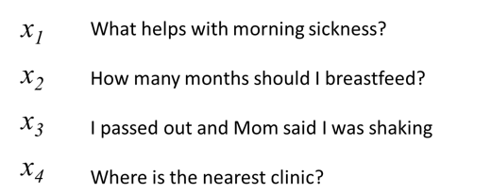
First try: count words in each SMS Step 1: Define a vocabulary of words
shaking
what
clinic
how
helps
was
nearest
many
with
said
months
the
morning
mom
should
sickness
and
I
is
how
out
breastfeed
passed
where
list of all words
(in no particular order)

Slide 13
Step 2: count how many times each vocabulary word appears in a given SMS
shaking
what
clinic
how
helps
was
nearest
many
with
said
months
the
morning
mom
should
sickness
and
I
is
how
out
breastfeed
passed
where
What helps with morning sickness?
x₁
0 | 1 | 0 | 0 | 1 | 0 | 0 | 0 | 1 | 0 | 0 | 0 | 1 | 0 | 0 | 1 | 0 | 0 | 0 | 0 | 0 | 0 | 0 | 0
Notes:
ACUTE PHYSIOLOGY AND CHRONIC HEALTH EVALUATION
Predictive models are nothing new in medicine – APACHE, for instance – this is to predict mortality in ICU setting – has been around since the 70s.
In an ICU setting, we might want a model that takes a bunch of measurements about a patient -- their age (demographics), vitals, lab values, and some information about chronic health conditions and predicts their risk of dying (or likelihood of surviving…)

Slide 14
Step 2: count how many times each vocabulary word appears in a given SMS
shaking
what
clinic
how
helps
was
nearest
many
with
said
months
the
morning
mom
should
sickness
and
I
is
how
out
breastfeed
passed
where
I passed out and Mom said I was shaking
x₃
1 | 0 | 0 | 0 | 0 | 1 | 0 | 0 | 0 | 1 | 0 | 0 | 0 | 1 | 0 | 0 | 0 | 2 | 0 | 0 | 1 | 0 | 1 | 0
Notes:
ACUTE PHYSIOLOGY AND CHRONIC HEALTH EVALUATION
Predictive models are nothing new in medicine – APACHE, for instance – this is to predict mortality in ICU setting – has been around since the 70s.
In an ICU setting, we might want a model that takes a bunch of measurements about a patient -- their age (demographics), vitals, lab values, and some information about chronic health conditions and predicts their risk of dying (or likelihood of surviving…)

Slide 15
Step 2: count how many times each vocabulary word appears in a given SMS
shaking
what
clinic
how
helps
was
nearest
many
with
said
months
the
morning
mom
should
sickness
and
I
is
how
out
breastfeed
passed
where
Where is the nearest clinic?
x₄
0 | 0 | 1 | 0 | 0 | 0 | 1 | 0 | 0 | 0 | 0 | 1 | 0 | 0 | 0 | 0 | 0 | 0 | 1 | 0 | 0 | 0 | 0 | 1
Notes:
ACUTE PHYSIOLOGY AND CHRONIC HEALTH EVALUATION
Predictive models are nothing new in medicine – APACHE, for instance – this is to predict mortality in ICU setting – has been around since the 70s.
In an ICU setting, we might want a model that takes a bunch of measurements about a patient -- their age (demographics), vitals, lab values, and some information about chronic health conditions and predicts their risk of dying (or likelihood of surviving…)

Slide 16
Note that word order does not matter!
shaking
what
clinic
how
helps
was
nearest
many
with
said
months
the
morning
mom
should
sickness
and
I
is
how
out
breastfeed
passed
where
clinic is where nearest the
x_{4'}
0 | 0 | 1 | 0 | 0 | 0 | 1 | 0 | 0 | 0 | 0 | 1 | 0 | 0 | 0 | 0 | 0 | 0 | 1 | 0 | 0 | 0 | 0 | 1
Notes:
ACUTE PHYSIOLOGY AND CHRONIC HEALTH EVALUATION
Predictive models are nothing new in medicine – APACHE, for instance – this is to predict mortality in ICU setting – has been around since the 70s.
In an ICU setting, we might want a model that takes a bunch of measurements about a patient -- their age (demographics), vitals, lab values, and some information about chronic health conditions and predicts their risk of dying (or likelihood of surviving…)

Slide 17

A “bag of words”
clinic
nearest
where
the
is

Slide 18
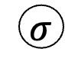
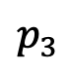
Logistic Regression for Text Classification
shaking
what
clinic
how
helps
was
nearest
many
with
said
months
the
morning
mom
should
sickness
and
I
is
how
out
breastfeed
passed
where
$$p_{3}$$
$$σ$$
z₃
b₁
b_{M}
x₃
1 | 0 | 0 | 0 | 0 | 1 | 0 | 0 | 0 | 1 | 0 | 0 | 0 | 1 | 0 | 0 | 1 | 2 | 0 | 0 | 1 | 0 | 1 | 0
I passed out and Mom said I was shaking

Slide 19
Logistic Regression for Text Classification
shaking
what
clinic
how
helps
was
nearest
many
with
said
months
the
morning
mom
should
sickness
and
I
is
how
out
breastfeed
passed
where
$$p_{3}$$
$$σ$$
z₃
b₁
b_{M}
x₃
1 | 0 | 0 | 0 | 0 | 1 | 0 | 0 | 0 | 1 | 0 | 0 | 0 | 1 | 0 | 0 | 1 | 2 | 0 | 0 | 1 | 0 | 1 | 0
I passed out and Mom said I was shaking

Slide 20
Logistic Regression for Text Classification
shaking
what
clinic
how
helps
was
nearest
many
with
said
months
the
morning
mom
should
sickness
and
I
is
how
out
breastfeed
passed
where
$$p_{3}$$
near 1 (urgent)
$$σ$$
large
z₃
b₁
b_{M}
x₃
1 | 0 | 0 | 0 | 0 | 1 | 0 | 0 | 0 | 1 | 0 | 0 | 0 | 1 | 0 | 0 | 1 | 2 | 0 | 0 | 1 | 0 | 1 | 0
I passed out and Mom said I was shaking

Slide 21
Strengths and Weaknesses
(+) This approach is simple and works surprisingly well in practice
(+) Often the best approach with small datasets
(-) Does not capture word order
(-) Does not group synonyms together or understand semantic relationships between words

Slide 22
2nd try: count 1- and 2-grams in each SMS (i.e. extend vocabulary to include 2-word phrases)
shaking
what
clinic
how
helps
was
nearest
many
with
said
months
the
morning
mom
should
sickness
and
I
is
how
out
breastfeed
passed
where
1-grams
what helps
helps with
with morning
morning sickness
how many
many months
months should
should I
I breastfeed
I passed
passed out
out and
and mom
mom said
said I
I was
was shaking
where is
is the
the nearest
nearest clinic
2-grams

Slide 23
n-grams can be very helpful!
I am not sick and feel great
Bag of 1-grams: no difference between these sentences
I am not great and feel sick

Slide 24
n-grams can be very helpful!
I am not sick and feel great
Bag of 1- and 2-grams:
not sick, feel great
versus
not great, feel sick
I am not great and feel sick

Slide 25
3rd try: more powerful methods to work with…
(a) word meaning: assign words to vectors that encode their meaning numerically
(b) words in context: neural network architectures that act on sequences of words (rather than a bag of words)

Slide 26
More Text Processing Details
(for bag of words models)

Slide 27
Variations on counting: term frequency
term count: ‘times’
“It was the best of times, it was the worst of times, it was the age of wisdom, it was the age of foolishness, it was the epoch of belief, it was the epoch of incredulity, it was the season of Light, it was the season of Darkness, it was the spring of hope, it was the winter of despair, we had everything before us, we had nothing before us, we were all going direct to Heaven, we were all going direct the other way—in short, the period was so far like the present period, that some of its noisiest authorities insisted on its being received, for good or for evil, in the superlative degree of comparison only.”
2
“And the first one now Will later be last For the times they are a-changin'.”
1

Slide 28
Variations on counting: term frequency
term frequency: ‘times’
“It was the best of times, it was the worst of times, it was the age of wisdom, it was the age of foolishness, it was the epoch of belief, it was the epoch of incredulity, it was the season of Light, it was the season of Darkness, it was the spring of hope, it was the winter of despair, we had everything before us, we had nothing before us, we were all going direct to Heaven, we were all going direct the other way—in short, the period was so far like the present period, that some of its noisiest authorities insisted on its being received, for good or for evil, in the superlative degree of comparison only.”
2/119
“And the first one now Will later be last For the times they are a-changin'.”
1/16
-> better measure of the importance of
the term within a given text sample

Slide 29
Variations on counting: inverse document frequency
2/2
document frequency: ‘times’
“It was the best of times, it was the worst of times, it was the age of wisdom, it was the age of foolishness, it was the epoch of belief, it was the epoch of incredulity, it was the season of Light, it was the season of Darkness, it was the spring of hope, it was the winter of despair, we had everything before us, we had nothing before us, we were all going direct to Heaven, we were all going direct the other way—in short, the period was so far like the present period, that some of its noisiest authorities insisted on its being received, for good or for evil, in the superlative degree of comparison only.”
✔
✔
“And the first one now Will later be last For the times they are a-changin'.”

Slide 30
Variations on counting: inverse document frequency
1/2
document frequency: ‘evil’
“It was the best of times, it was the worst of times, it was the age of wisdom, it was the age of foolishness, it was the epoch of belief, it was the epoch of incredulity, it was the season of Light, it was the season of Darkness, it was the spring of hope, it was the winter of despair, we had everything before us, we had nothing before us, we were all going direct to Heaven, we were all going direct the other way—in short, the period was so far like the present period, that some of its noisiest authorities insisted on its being received, for good or for evil, in the superlative degree of comparison only.”
✔
X
“And the first one now Will later be last For the times they are a-changin'.”

Slide 31
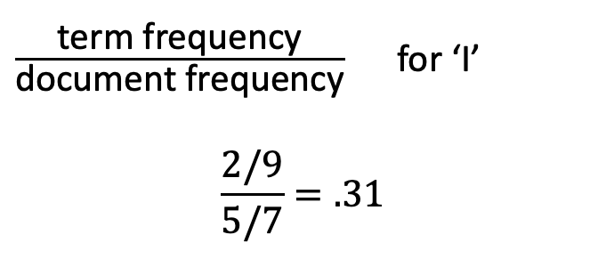
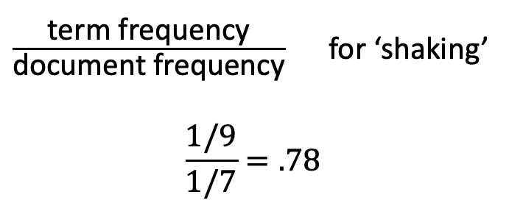
term frequency-inverse document frequency (tf-idf)
What helps with morning sickness?
How many months should I breastfeed?
I passed out and Mom said I was shaking
Where is the nearest clinic?
I am having heavy bleeding, what should I do?
What foods should I eat while pregnant?
My heart is racing and I can’t catch my breath
$\frac{\text{term} \text{frequency}}{\text{document} \text{frequency}}$ for ‘shaking’
$$\frac{1/9}{1/7}=.78$$
$\frac{\text{term} \text{frequency}}{\text{document} \text{frequency}}$ for ‘I’
$$\frac{2/9}{5/7}=.31$$

Slide 32
Preprocessing
I passed out, and Mom said I was shaking.
remove punctuation
to lowercase
“tokenization”
“stemming”
I passed out and Mom said I was shaking
i passed out and mom said i was shaking
[i, passed, out, and, mom, said, i, was, shaking]
[i, pass, out, and, mom, said, i, wa, shake]

Slide 33
Summary
Point 1
Point 2
Point 3

